Slide 1
Self Introduction
David Ishak Kosasih – 20195033 | Dongseo University

Slide 2
Self Introduction
Name : David Ishak Kosasih
Nationality : Indonesia
Place & Date of birth : Surabaya, 14 January 1994
Lab : Cloud computing
Supervisor : Prof. 임효택

Slide 3
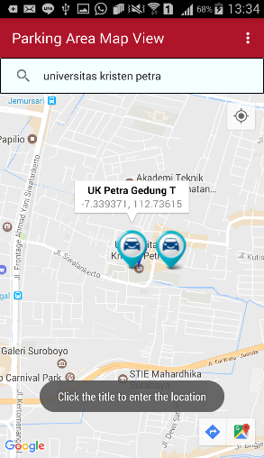
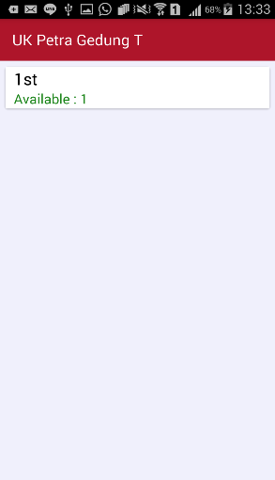
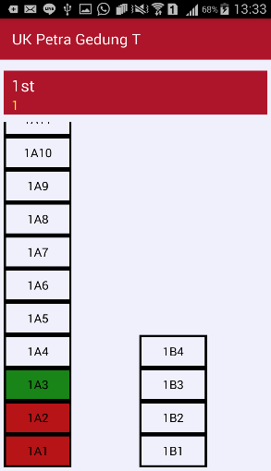
Background
Education :
2013-2017
BEng Electrical engineering, Petra Christian University
Thesis : Mobile Application For Internet of Things (IoT)–Based Parking Systems

Slide 4
Background
Research Experience :
2018-2019
Incubator Tenants, Innovation & Entrepreneurship Centre

Slide 5
Research Topic
Research area
Cloud computing, machine learning, deep learning, telehealth
Research topic :
PPG, ECG and cloud computing
Location tracking

Slide 6
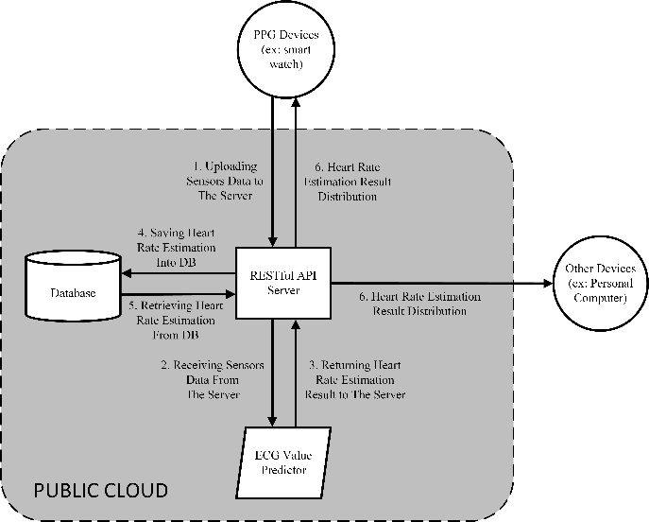
Research Topic
On going research
Title : Improving Heart Rate Calculation Accuracy from PPG Data by Predicting Its Corresponding ECG Value Using Neural Network and Cloud Computing

Slide 7

감사합니다 Thank You
Notes:
This is the question that your experiment answers

